Slide 1
The Development of Hardware Correlator in SHAO
Zhijun Xu
Shanghai Astronomical Observatory, CAS

Slide 2
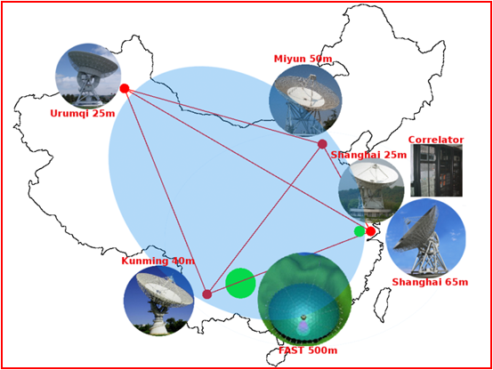
VLBI in China

Slide 3
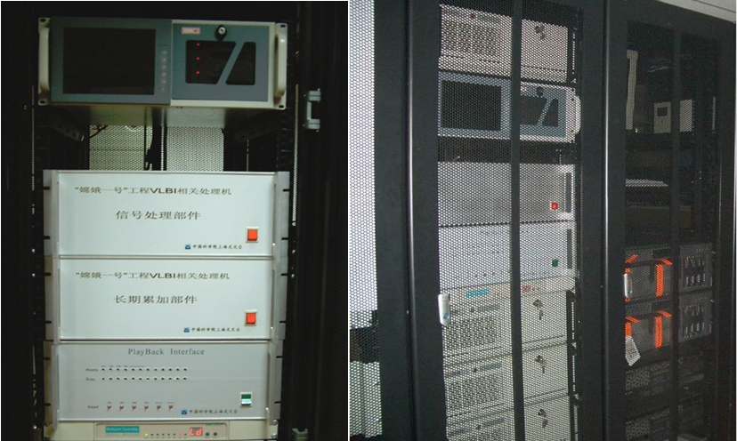
CE-1 & CE-2 Hardware Correlator

Slide 4
CE-1 & CE-2 Hardware Correlator

Slide 5
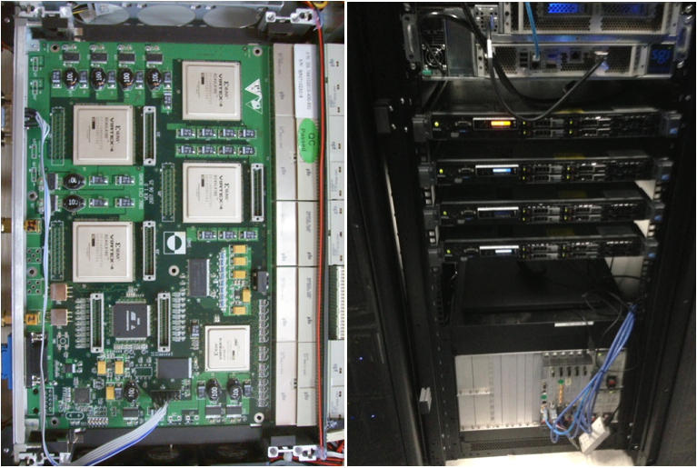
CE-3 Hardware Correlator

Slide 6
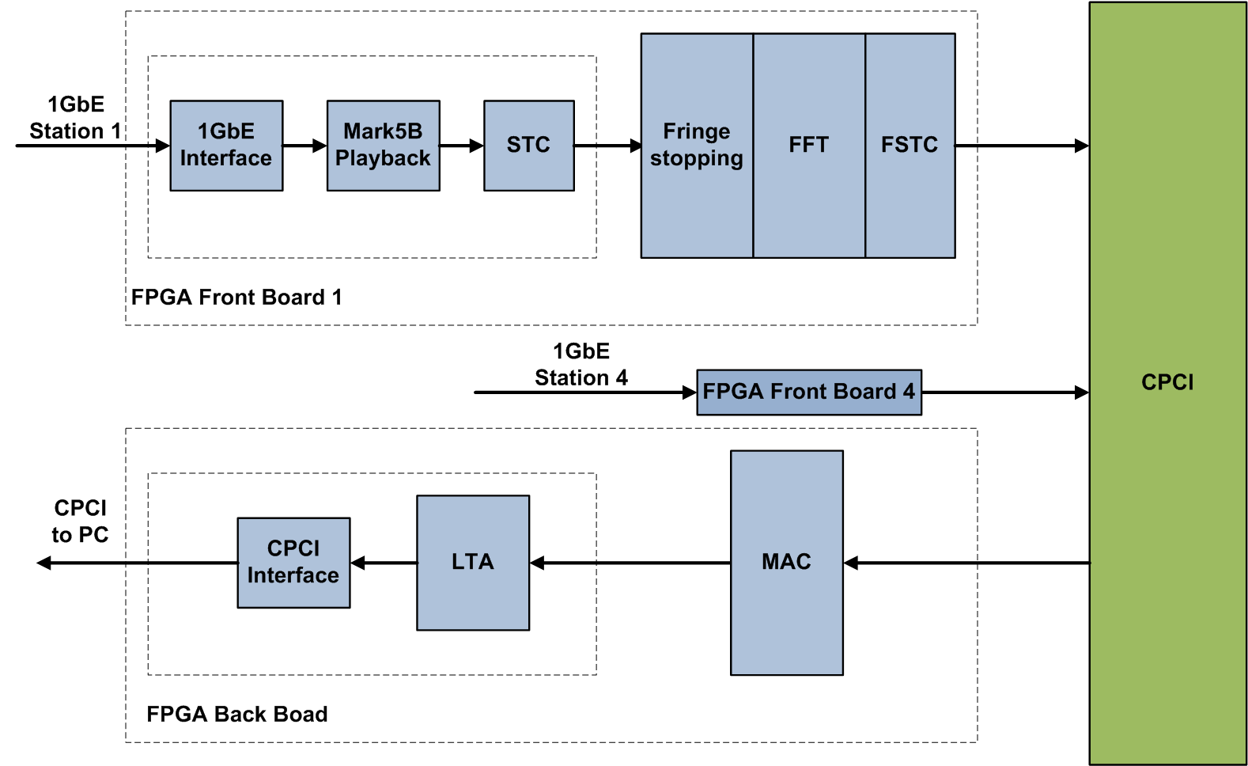
CE-3 Hardware Correlator

Slide 7
Uniboard Correlator

Slide 8
Uniboard Correlator

Slide 9
Correlator Data Explosion
Module | Function | Volume
Data Playback | 256MHz *1bits*1station*32channel | 8Gbps/chip
Quantification | 256MHz*16bits*1station*32channel | 128Gbps/chip
Fringe Stopping | 256MHz*16bits*1station*32channel*2complex | 256Gbps/chip
FFT | 256MHz*16bits*1station*32channel*2complex /2symmetry | 128Gbps/chip
FSTC | 256MHz*16bits*1station*32channel*2complex /2symmetry | 128Gbps/chip
MAC | 256MHz*32bits*10baseline*8channel*2complex /2symmetry | 640Gbps/chip
LTA | (32bits*32channel*2complex*10baseline*1024fftsize /2symmety)/1s integration | 10Mbps

Slide 10
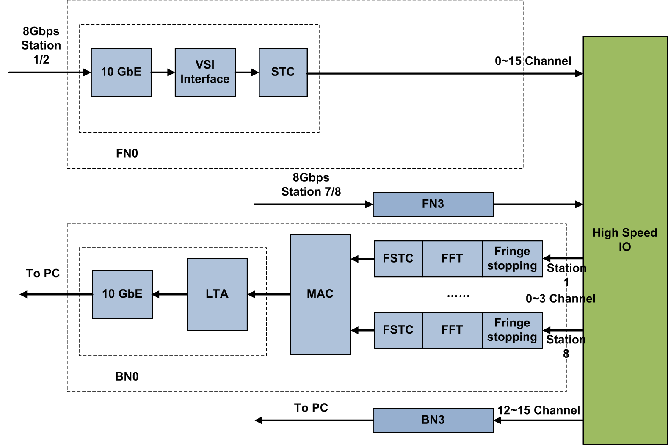
Uniboard Correlator v2

Slide 11
Correlator Data Explosion
Module | Function | Volume
Data Playback | 256MHz *1bits*1station*32channel | 8Gbps/chip
Quantification | 256MHz*16bits*4station*8channel | 128Gbps/chip
Fringe Stopping | 256MHz*16bits*4station*8channel*2complex | 256Gbps/chip
FFT | 256MHz*16bits*4station*8channel*2complex /2symmetry | 128Gbps/chip
FSTC | 256MHz*16bits**4station*8channel*2complex /2symmetry | 128Gbps/chip
MAC | 256MHz*32bits*10baseline*8channel*2complex /2symmetry | 640Gbps/chip
LTA | (32bits*32channel*2complex*10baseline*1024fftsize /2symmety)/1s integration | 10Mbps

Slide 12
Some Result
From same source and sample by 2 CDAS2 (16channel 2bits 512MHzBW)

Slide 13
Further Thoughts

Slide 14
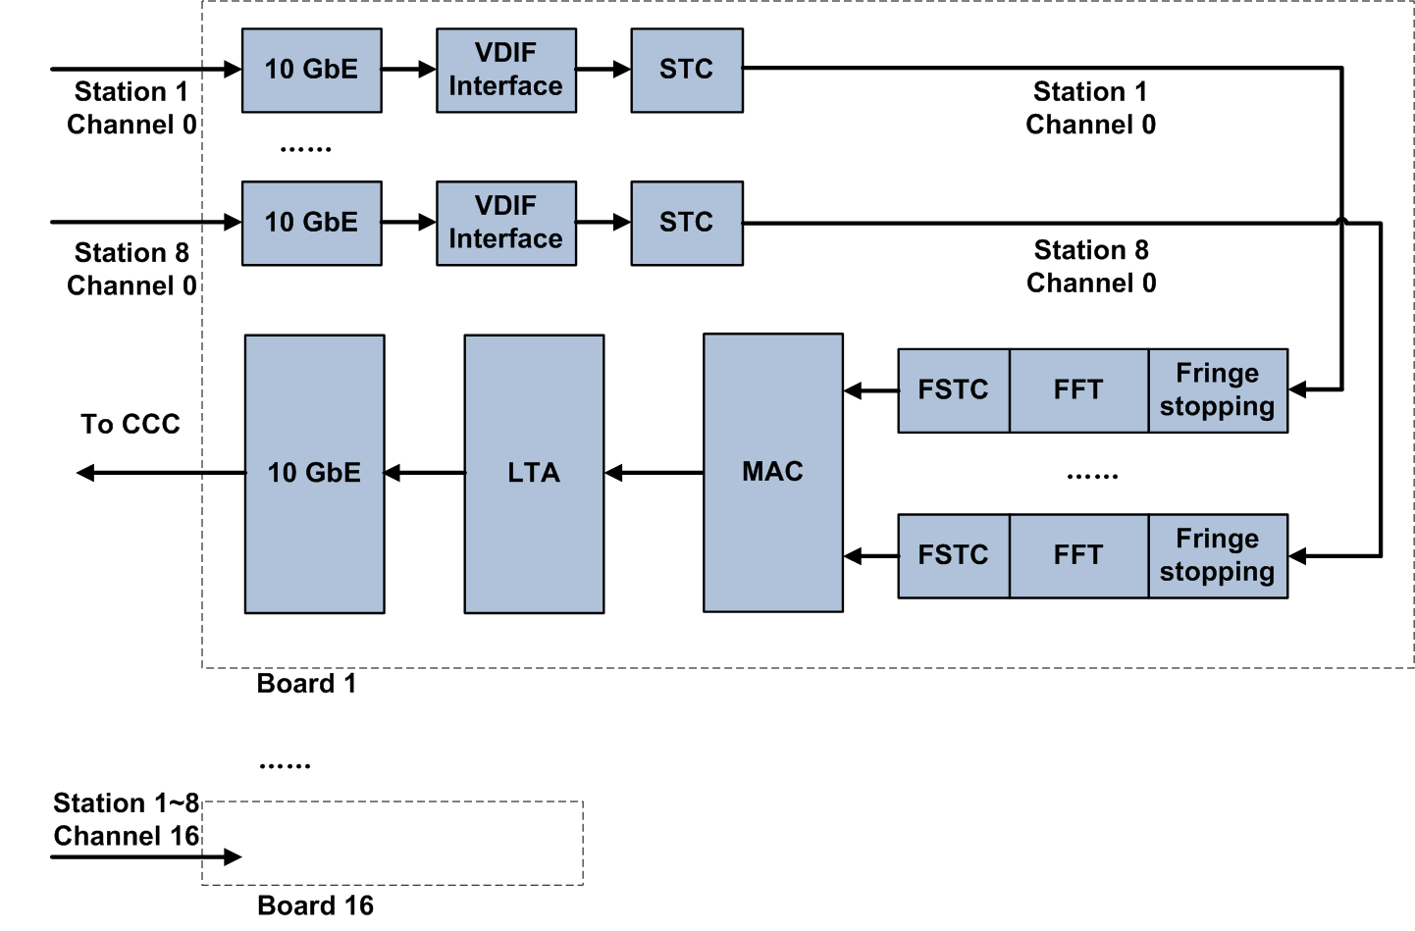
Further Thoughts

Slide 15
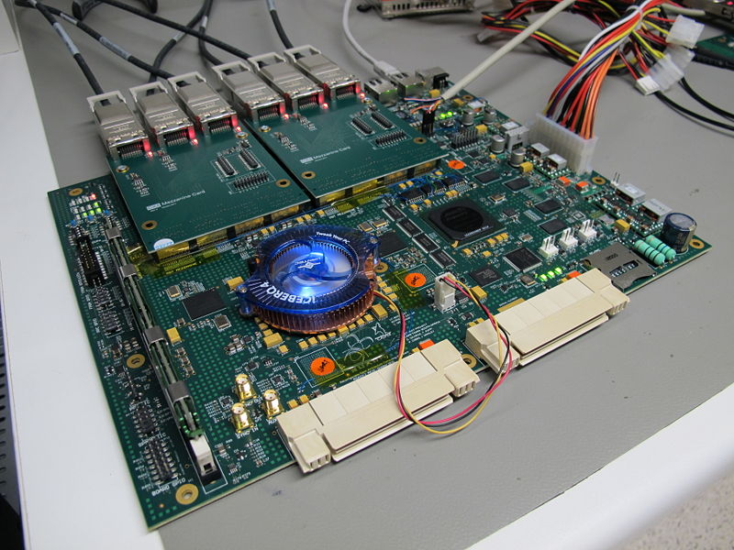
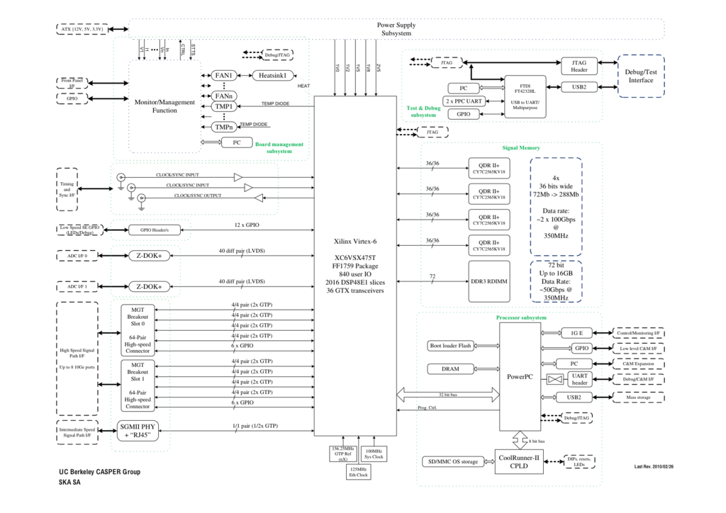
ROACH-2

Slide 16
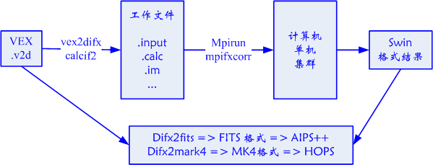
Further Thoughts

Slide 17
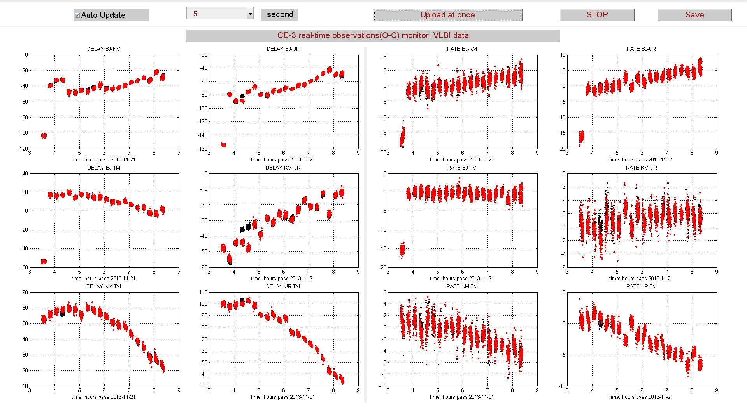
CE-3
Red Hardware Correlator
Black Software Correlator

Slide 18
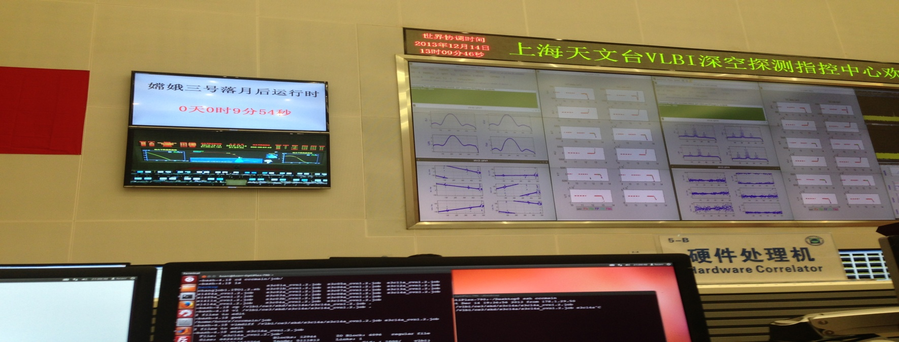
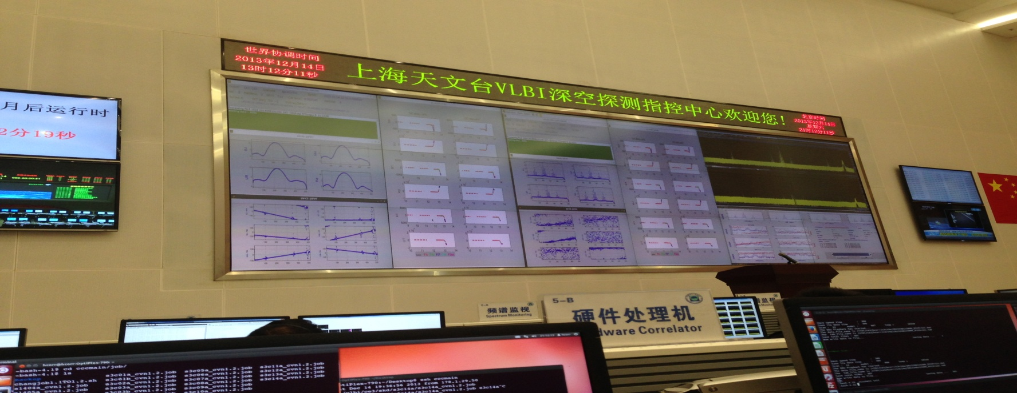
CE-3

Slide 19
CE-5T1

Slide 20
Hardware Correlator Team

Slide 21
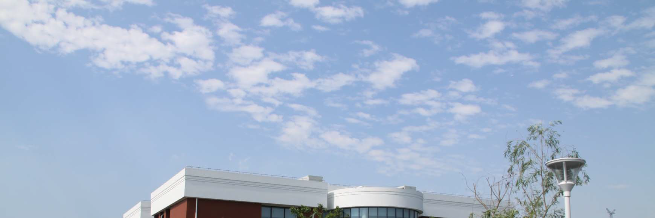
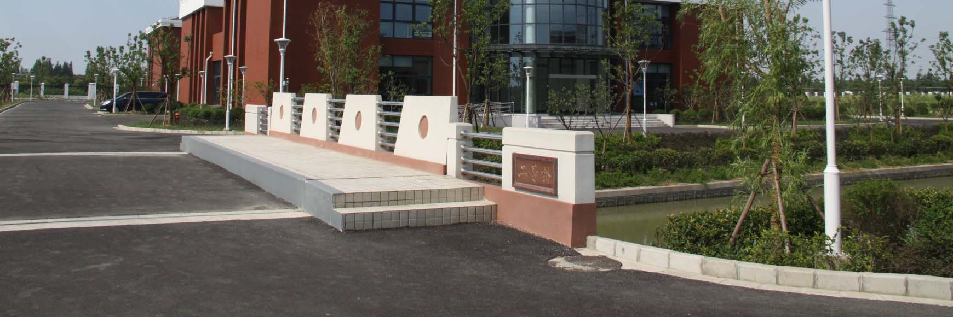
Thank You !

